Slide 1
8
Disk Storage, Basic File Structures, and Hashing

Slide 2
8.4 Hashing Techniques

Slide 3
Hashing Techniques
Hash function (randomizing function)
Applied to hash field value of a record
Yields address of the disk block of stored record
Organization called hash file
Search condition is equality condition on the hash field
Hash field typically key field
Hashing also internal search structure
Used when group of records accessed exclusively by one field value

Slide 4
Hashing Techniques
A function h, called a hash function or randomizing function, is applied to the hash field value of a record and yields the address of the disk block in which the record is stored.
A search for the record within the block can be carried out in a main memory buffer.
For most records, we need only a single-block access to retrieve that record.
Hashing is also used as an internal search structure within a program whenever a group of records is accessed exclusively by using the value of one field.

Slide 5
Hashing Techniques
Internal hashing
Hash table
Collision
Hash field value for inserted record hashes to address already containing a different record
Collision resolution
Open addressing
Chaining
Multiple hashing
 | Name | SSN | Job | Salary
0
1
2
M-2
M-1

Slide 6
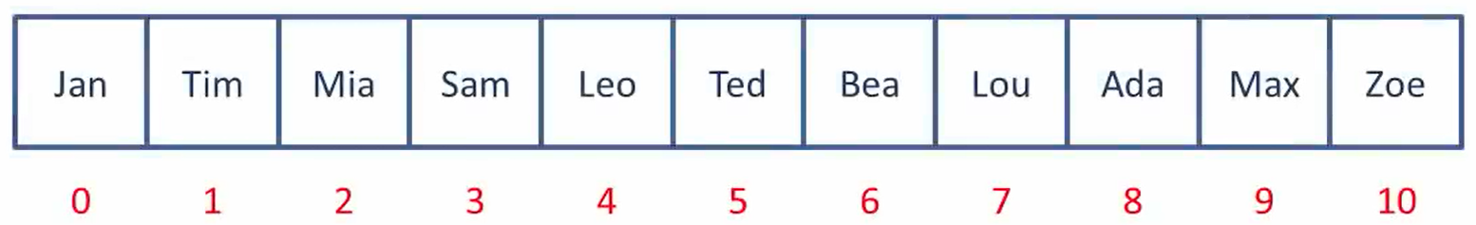
Find Ada
What if we have thousands or millions of records?
Jan
Tim
Mia
Sam
Leo
Ted
Beau
Lou
Ada

Slide 7
Hashing
Mia
M
77
i
105
a
97
279
4
Total mod 11
Tim
T
84
i
105
m
109
298
1
Bea
B
66
e
101
a
97
264
0
Zoe
Z
90
o
111
e
101
302
5
Jan
J
74
a
97
n
110
281
6
Ada
A
65
d
100
a
97
262
9
Leo
L
76
e
101
o
111
288
2
Sam
S
83
a
97
m
109
289
3
Lou
L
76
o
111
u
117
304
7
Max
M
77
a
97
x
120
294
8
Ted
T
84
e
101
d
100
285
10
0 | 1 | 2 | 3 | 4 | 5 | 6 | 7 | 8 | 9 | 10
Bea
Tim
Leo
Sam
Mia
Zoe
Jan
Lou
Max
Ada
Ted

Slide 8
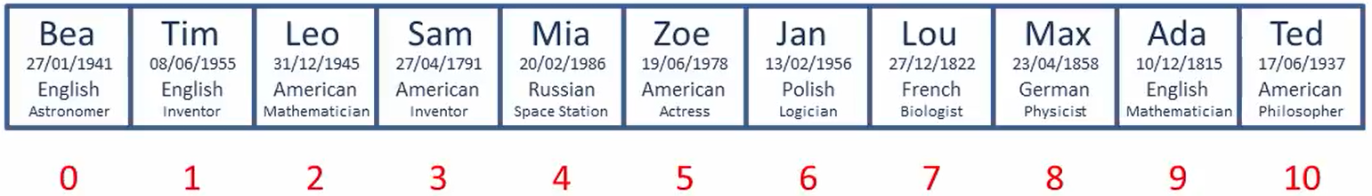
Find Ada
Key Value Pair
Index = SUM(ASCII Codes) Mod Size
Ada
10/12/1885
Mathematician
…
SUM = 65 + 100 + 97 = 262
Index = 262 Mod 11 = 9
0 | 1 | 2 | 3 | 4 | 5 | 6 | 7 | 8 | 9 | 10
Bea
Tim
Leo
Sam
Mia
Zoe
Jan
Lou
Max
Ada
Ted
Ada

Slide 9
Open addressing
Mia
M
77
i
105
a
97
279
4
Tim
T
84
i
105
m
109
298
1
Bea
B
66
e
101
a
97
264
0
Zoe
Z
90
o
111
e
101
302
5
Sue
S
83
U
117
n
101
301
4
Len
L
76
e
101
n
110
287
1
Moe
M
77
o
111
e
101
289
3
Lou
L
76
o
111
u
117
304
7
Rae
R
82
a
97
e
101
280
5
Max
M
77
a
97
x
120
294
8
Tod
T
84
o
111
d
100
295
9
0 | 1 | 2 | 3 | 4 | 5 | 6 | 7 | 8 | 9 | 10
Bea
Tim
Len
Moe
Mia
Zoe
Sue
Lou
Rae
Max
Tod

Slide 10
Find Rae
Total Nº of Items Loaded
Load Factor =
Total Capacity
Index = SUM(ASCII Codes) Mod Size
SUM = 82 + 97 + 101 = 280
Index = 280 Mod 11 = 5
0 | 1 | 2 | 3 | 4 | 5 | 6 | 7 | 8 | 9 | 10
Sue
Lou
Rae
Bea
Tim
Len
Moe
Mia
Zoe
Rae
Max
Tod

Slide 11
Chaining
0
1
2
3
4
5
6
7
8
9
10
Bea
Mia
M
77
i
105
a
97
279
4
Tim
T
84
i
105
m
109
298
1
Tim
Len
Bea
B
66
e
101
a
97
264
0
Zoe
Z
90
o
111
e
101
302
5
Moe
Sue
S
83
U
117
n
101
301
4
Len
L
76
e
101
n
110
287
1
Mia
Sue
Moe
M
77
o
111
e
101
289
3
Rae
Zoe
Rae
Lou
L
76
o
111
u
117
304
7
Rae
R
82
a
97
e
101
280
5
Max
M
77
a
97
x
120
294
8
Lou
Tod
T
84
o
111
d
100
295
9
Max
Index = SUM(ASCII Codes) Mod Size
Tod
SUM = 82 + 97 + 101 = 280
Find Rae
Index = 280 Mod 11 = 5

Slide 12
Objective of a Hash Function
Minimum Collision
Uniform Distribution of Hash values
Easy to compute
Resolve any Collisions
Notes:
Non-integer hash field values can be transformed into integers before the mod function is applied. For character strings, the numeric (ASCII) codes associated with characters can be used in the transformation

Slide 13
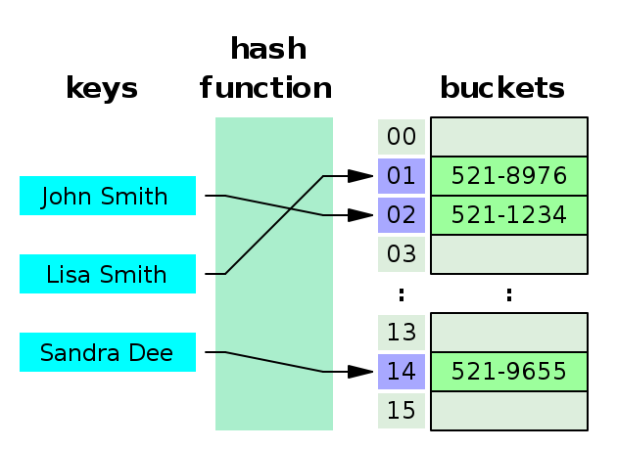
Hashing Techniques (cont’d.)
Internal hashing
Hash table
We choose a hash function that transforms the hash field value into an integer between 0 and M − 1.
One common hash function is the h(K) = K mod M function, which returns the remainder of an integer hash field value K after division by M; this value is then used for the record address.
Notes:
Non-integer hash field values can be transformed into integers before the mod function is applied. For character strings, the numeric (ASCII) codes associated with characters can be used in the transformation

Slide 14
Algorithm 16.2. Two simple hashing algorithms
(a) Applying the mod hash function to a character string K.
(b) Collision resolution by open addressing.
(a) temp ← 1;
for i ← 1 to 20 do temp ← temp * code(K[i] ) mod M ;
hash_address ← temp mod M;
(b) i ← hash_address(K);
a ← i;
if location i is occupied then
begin i ← (i + 1) mod M;
while (i≠a) and location i is occupied do i ← (i+1) mod M;
if (i=a) then all positions are full else new_hash_address ←i;
end

Slide 15
Hash Collision and Collision Resolution
Collision
A collision occurs when the hash field value of a record that is being inserted hashes to an address that already contains a different record.
Collision resolution
The process of finding another position
Open addressing.
checks the subsequent positions in order until an unused (empty) position is found
Chaining.
Multiple hashing.
Notes:
Collision resolution: The process of finding another position

Slide 16
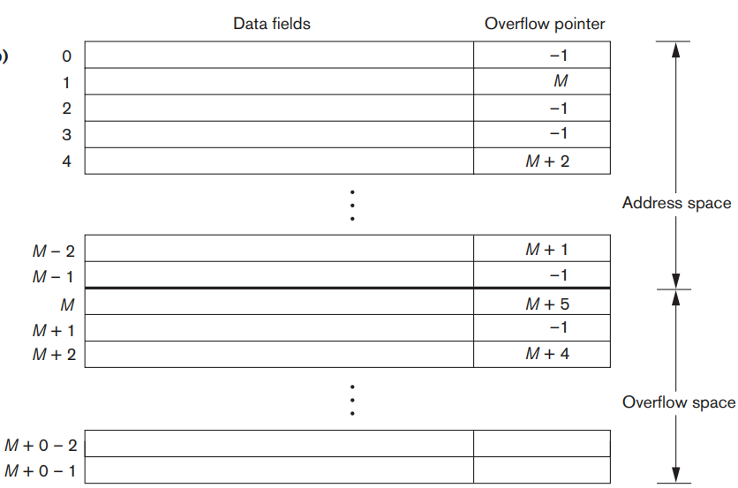

Hash Collision Resolution: Separate chaining
A collision is resolved by placing the new record in an unused overflow location and setting the pointer of the occupied hash address location to the address of that overflow location.
NULL Pointer = –1
position of next record in linked list
Notes:
Various overflow locations are kept, usually by extending the array with a number of overflow positions. Additionally, a pointer field is added to each record location. A linked list of overflow records for each hash address is thus maintained

Slide 17
Example: Separate chaining
Example:
Let hash function h = “key mod 7” and keys { 50, 700, 76, 85, 92, 73, 101}
Insert 50: h = 50%7 = 1
0
1
2
3
4
5
6
700
Insert 700: h = 700%7 = 0
50
85
92
Insert 76: h = 76%7 = 6
Insert 85: h = 85%7 = 1
73
101
Insert 92: h = 92%7 = 1
Insert 73: h = 73%7 = 3
76
Insert 101: h = 101%7 = 3
Notes:
Collision resolution: The process of finding another position

Slide 18
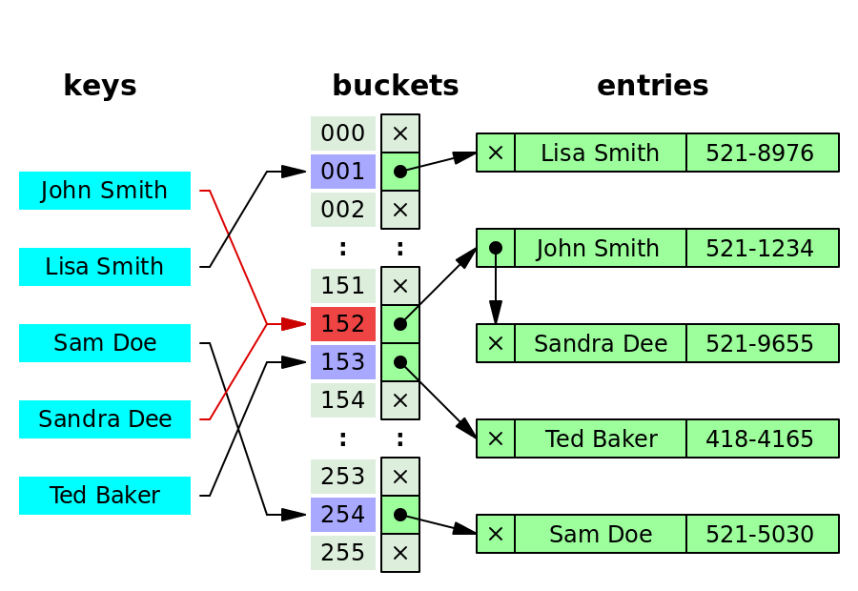
Hash Collision Resolution: Separate chaining
Each bucket is independent, and has some sort of list of entries with the same index.
Notes:
Collision resolution: The process of finding another position

Slide 19
Hash Collision Resolution: Multiple Hashing
Applies a second hash function if the first results in a collision.
If another collision results, the program uses open addressing or applies a third hash function and then uses open addressing if necessary.
Note that the series of hash functions are used in the same order for retrieval.
For example,
h(h(h(h(x)))) is often denoted h⁴(x)
Notes:
Collision resolution: The process of finding another position

Slide 20
Hash Collision Resolution
Each collision resolution method requires its own algorithms for insertion, retrieval, and deletion of records.
The algorithms for chaining are the simplest.
Deletion algorithms for open addressing are rather tricky.
It may also be useful to choose a prime number for M, as it distributes the hash addresses better over the address space when the mod hashing function is used modulo a prime number.
Other hash functions may require M to be a power of 2.
Notes:
Collision resolution: The process of finding another position

Slide 21
Goal of A Good Hashing Function
To distribute the records uniformly over the address space so as to minimize collisions, thus making it possible to locate a record with a given key in a single access.
To occupy the buckets fully, thus not leaving many unused locations.
Simulation and analysis studies have shown that it is usually best to keep a hash file between 70 and 90% full so that the number of collisions remains low and we do not waste too much space.
Hence, for r records and M locations (r/M) should be between 0.7 and 0.9.
Notes:
Collision resolution: The process of finding another position

Slide 22
External hashing for disk files
External hashing for disk files
Target address space made of buckets
Bucket: one disk block or contiguous blocks
Hashing function maps a key into relative bucket
Table in file header converts bucket number to disk block address
Collision problem less severe with buckets
Static hashing
Fixed number of buckets allocated

Slide 23
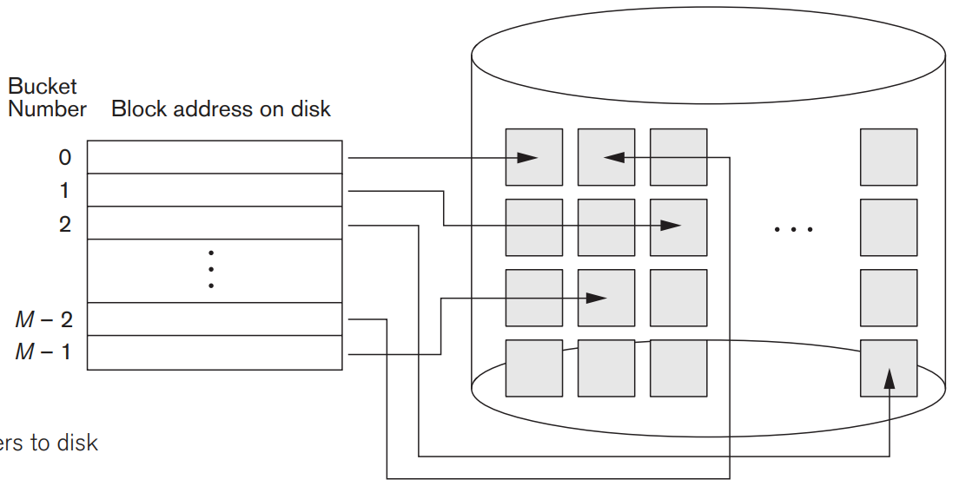
External hashing for disk files
External hashing for disk files
Target address space made of buckets
Bucket: one disk block or contiguous blocks
Matching bucket numbers to disk block addresses
Notes:
Hashing for disk files is called external hashing. To suit the characteristics of disk storage, the target address space is made of buckets, each of which holds multiple records. A bucket is either one disk block or a cluster of contiguous disk blocks. The hashing function maps a key into a relative bucket number rather than assigning an absolute block address to the bucket.

Slide 24
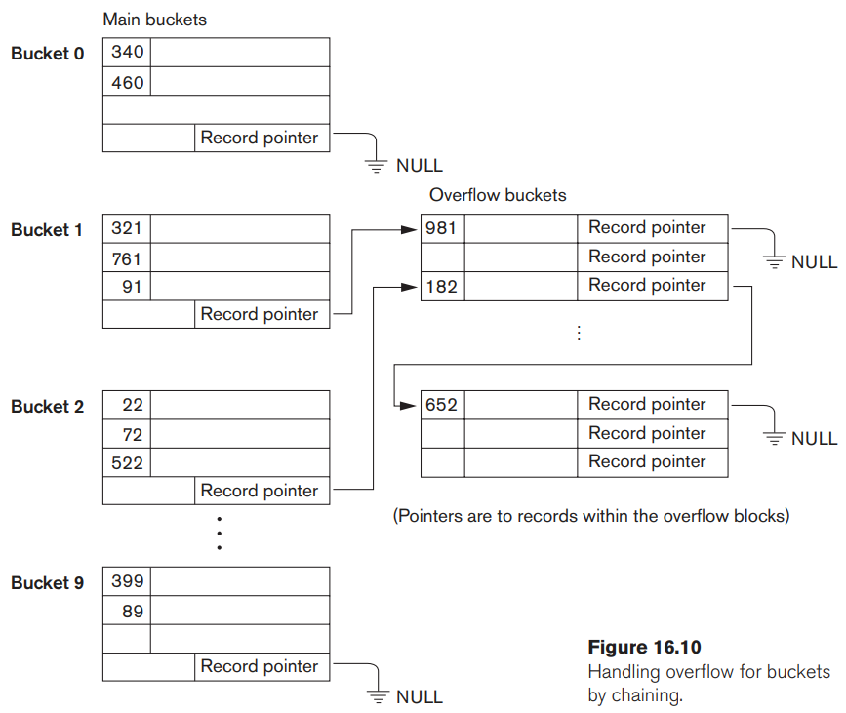
External hashing for disk files
The collision problem is less severe with buckets.
Notes:
The collision problem is less severe with buckets, because as many records as will fit in a bucket can hash to the same bucket without causing problems.

Slide 25
When using external hashing
Searching
Searching for a record given a value of some field other than the hash field is as expensive as in the case of an unordered file.
Record deletion can be implemented by removing the record from its bucket.
If the bucket has an overflow chain, we can move one of the overflow records into the bucket to replace the deleted record.
If the record to be deleted is already in overflow, we simply remove it from the linked list.
Notes:
Notice that removing an overflow record implies that we should keep track of empty positions in overflow. This is done easily by maintaining a linked list of unused overflow locations.

Slide 26
When using external hashing
Modifying a specific record’s field value depends on two factors:
the search condition to locate that specific record and
the field to be modified.
If the search condition is an equality comparison on the hash field,
we can locate the record efficiently by using the hashing function;
otherwise, we must do a linear search. A non-hash field can be modified by changing the record and rewriting it in the same bucket.
Modifying the hash field means that the record can move to another bucket,
which requires deletion of the old record followed by insertion of the modified record.
Notes:
If the search condition is an equality comparison on the hash field, we can locate the record efficiently by using the hashing function; otherwise, we must do a linear search. A non-hash field can be modified by changing the record and rewriting it in the same bucket.
Modifying the hash field means that the record can move to another bucket, which requires deletion of the old record followed by insertion of the modified record.

Slide 27
Hashing - Order Preserving
A hash function F is order preserving if keys are given in some order a₁, a₂, ..., a_{n} and for any keys a_{j} and a_{k}, j < k implies F(a_{j}) < F(a_{k}).
A simple example
take the leftmost three digits of an invoice number field that yields a bucket address as the hash address and keep the records sorted by invoice number within each bucket.
use an integer hash key directly as an index to a relative file, if the hash key values fill up a particular interval;
for example, if employee numbers in a company are assigned as 1, 2, 3, … up to the total number of employees, we can use the identity hash function (i.e., Relative Address = Key) that maintains order.

Slide 28
Limitations of Static Hashing
Fixing the address space can be a serious drawback for dynamic files.
If we allocate M buckets for the address space and let m is the maximum number of records that can fit in one bucket; then at most (m * M) records will fit in the allocated space.
If the number of records turns out to be substantially fewer than (m * M),
we are left with a lot of unused space.
if the number of records increases to substantially more than (m * M)
numerous collisions will result and retrieval will be slowed down because of the long lists of overflow records.
Newer dynamic file organizations based on hashing allow the number of buckets to vary dynamically with only localized reorganization
Notes:
The hashing scheme described so far is called static hashing because a fixed number of buckets M is allocated. we may have to change the number of blocks M allocated and then use a new hashing function (based on the new value of M) to redistribute the records. These reorganizations can be quite time-consuming for large files.

Slide 29
Hashing techniques that allow dynamic file expansion
Extendible hashing
File performance does not degrade as file grows
Dynamic hashing
Maintains tree-structured directory
Linear hashing
Allows hash file to expand and shrink buckets without needing a directory

Slide 30
Hashing Techniques: Extendible hashing
Stores an access structure in addition to the file; the access structure is based on the values that result after application of the hash function to the search field.
A type of directory—an array of 2^{d} bucket addresses—is maintained, where d is called the global depth of the directory.
Splitting causes minor reorganization in most cases, since only the records in one bucket are redistributed to the two new buckets.
More expensive is when the directory has to be doubled (or halved).
the directory must be searched before accessing the buckets themselves, resulting in two block accesses instead of one in static hashing.
This performance penalty is considered minor and thus the scheme is considered quite desirable for dynamic files.
Notes:
The space overhead for the directory table is negligible. The maximum directory size is 2k , where k is the number of bits in the hash value. Another advantage is that splitting causes minor reorganization in most cases, since only the records in one bucket are redistributed to the two new buckets. The only time reorganization is more expensive is when the directory has to be doubled (or halved). A disadvantage is that the directory must be searched before accessing the buckets themselves, resulting in two block accesses instead of one in static hashing. This performance penalty is considered minor and thus the scheme is considered quite desirable for dynamic files.

Slide 31
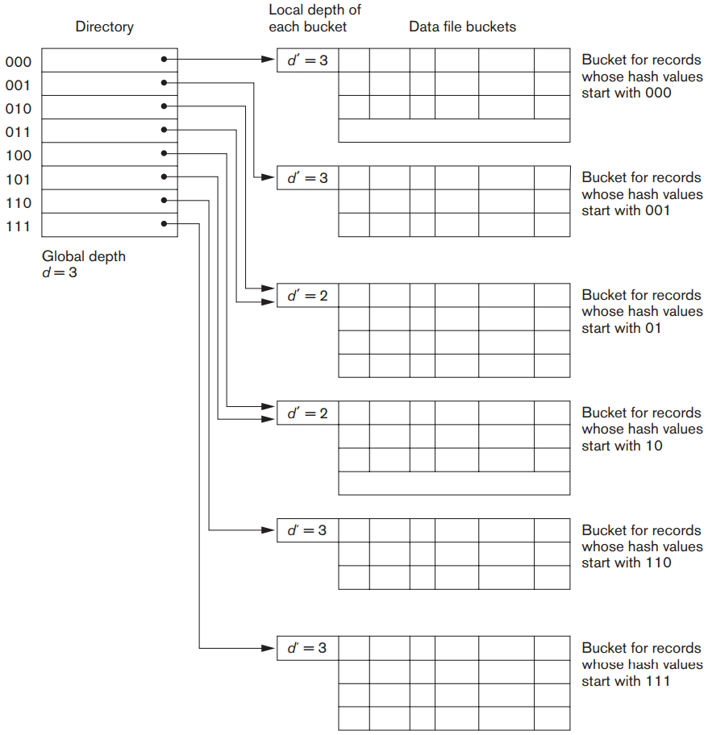
Extendible Hashing
There does not have to be a distinct bucket for each of the directory locations.
The value of d can be increased or decreased by one at a time doubling or halving the number of entries in the directory array.
Doubling is needed if a bucket, whose local depth d′ == d overflows.
Halving occurs if d > d′ for all the buckets after some deletions occur.
Notes:
There does not have to be a distinct bucket for each of the 2^{d} directory locations. Several directory locations with the same first d′ bits for their hash values may contain the same bucket address if all the records that hash to these locations fit in a single bucket. A local depth d′—stored with each bucket—specifies the number of bits on which the bucket contents are based. Figure 16.11 shows a directory with global depth d = 3.

Slide 32
Extendible Hashing: Insert a new record
Insert a new record whose hash values start with 01 and causes overflow.
The records will be distributed between two buckets:
the first contains all records whose hash values start with 010, and
the second all those whose hash values start with 011.
Now the two directory locations for 010 and 011 point to the two new distinct buckets. The local depth d′ of the two new buckets is 3.
Notes:
suppose that a new inserted record causes overflow in the bucket whose hash values start with 01—the third bucket in Figure 16.11. The records will be distributed between two buckets: the first contains all records whose hash values start with 010, and the second all those whose hash values start with 011. Now the two directory locations for 010 and 011 point to the two new distinct buckets. Before the split, they pointed to the same bucket. The local depth d′ of the two new buckets is 3, which is one more than the local depth of the old bucket.

Slide 33
Extendible Hashing: Insert a new record
If the bucket for records whose hash values start with 111 overflows,
the two new buckets need a directory with global depth d = 4, because the two buckets are now labeled 1110 and 1111, and hence their local depths are both 4.
The directory size is hence doubled, and each of the other original locations in the
Notes:
If a bucket that overflows and is split used to have a local depth d′ equal to the global depth d of the directory, then the size of the directory must now be doubled so that we can use an extra bit to distinguish the two new buckets.
For example, if the bucket for records whose hash values start with 111 in Figure 16.11 overflows, the two new buckets need a directory with global depth d = 4, because the two buckets are now labeled 1110 and 1111, and hence their local depths are both 4. The directory size is hence doubled, and each of the other original locations in the

Slide 34
Extendible Hashing: Example
Key Binary Data
01 0001 data01
07 0111 data02
03 0011 data03
08 1000 data04
12 1100 data05
14 1110 data06
11 1011 data07
02 0010 data08
10 1010 data09
13 1101 data10
04 0100 data11
09 1001 data12
After inserting 1, 7, 3, 8, 12, 14:
D = 1
1
7
3
0
1
D = 1
8
12
14
Global Depth = 1
Inserting 11 produces overflow on bucket₁
D = 1
1
7
3
00
01
D = 2
10
8
11
11
Global Depth = 2
D = 2
12
14

Slide 35
Extendible Hashing: Example
Key Binary Data
01 0001 data01
07 0111 data02
03 0011 data03
08 1000 data04
12 1100 data05
14 1110 data06
11 1011 data07
02 0010 data08
10 1010 data09
13 1101 data10
04 0100 data11
09 1001 data12
D = 1
1
7
3
00
01
D = 2
10
8
11
11
Global Depth = 2
D = 2
12
14
Inserting 2 produces overflow on bucket₀
D = 2
1
3
2
00
D = 2
01
7
10
D = 2
11
8
11
Global Depth = 2
D = 2
12
14

Slide 36
Extendible Hashing: Example
Key Binary Data
D = 2
01 0001 data01
07 0111 data02
03 0011 data03
08 1000 data04
12 1100 data05
14 1110 data06
11 1011 data07
02 0010 data08
10 1010 data09
13 1101 data10
04 0100 data11
09 1001 data12
1
3
2
00
D = 2
01
7
10
D = 2
11
8
11
Global Depth = 2
D = 2
12
14
Inserting 10, 13, 4
D = 2
1
3
2
00
D = 2
01
7
4
10
D = 2
11
8
11
10
Global Depth = 2
D = 2
12
14
13

Slide 37
Extendible Hashing: Example
Key Binary Data
D = 2
01 0001 data01
07 0111 data02
03 0011 data03
08 1000 data04
12 1100 data05
14 1110 data06
11 1011 data07
02 0010 data08
10 1010 data09
13 1101 data10
04 0100 data11
09 1001 data12
1
3
2
00
D = 2
01
7
10
D = 2
11
8
11
D = 2
Global Depth = 2
12
14
Inserting 9 produces overflow on bucket₁₀
000
D = 2
001
1
3
2
D = 2
010
7
4
011
D = 3
100
8
9
101
D = 3
110
11
10
111
D = 2
Global Depth = 3
12
14
13

Slide 38
Hashing Techniques: Dynamic Hashing
Dynamic hashing maintains a tree-structured directory with two types of nodes:
Internal nodes that have two pointers
the left pointer corresponding to the 0 bit (in the hashed address) and
a right pointer corresponding to the 1 bit.
Leaf nodes
these hold a pointer to the actual bucket with records

Slide 39
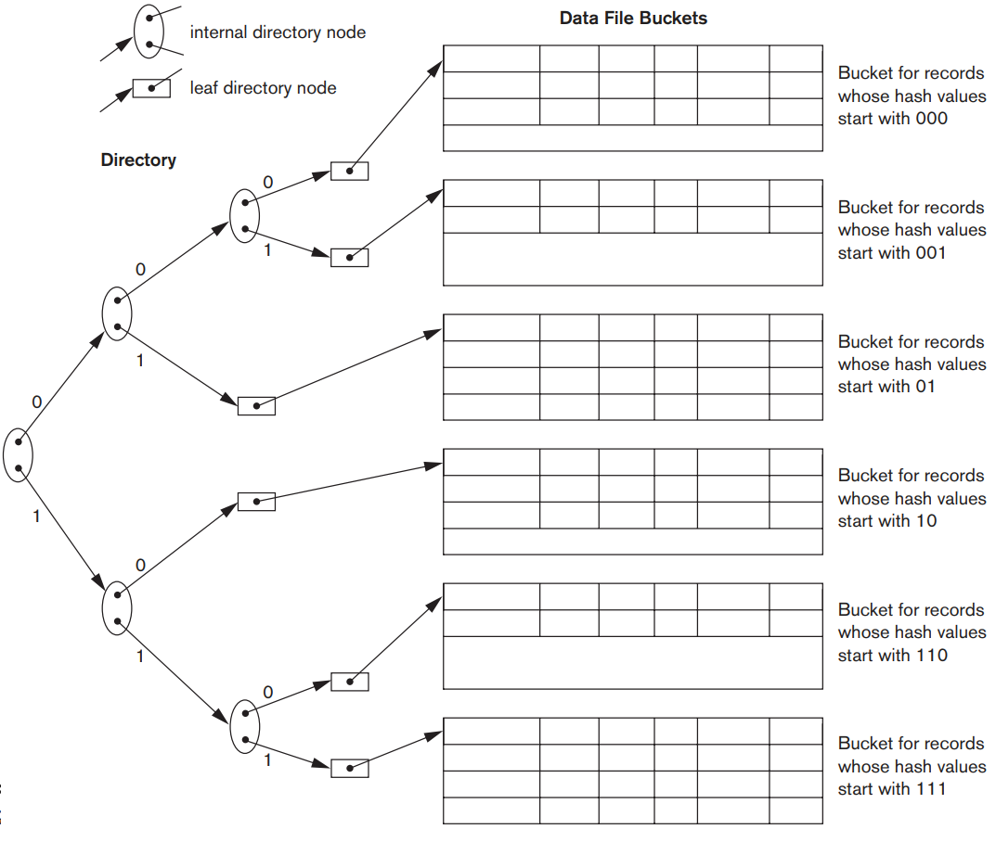
Dynamic Hashing
The search for a record given the hashed address involves traversing the directory tree, which leads to the bucket holding that record.
Notes:
the result of collapsing the “010” and “011” into “01” and collapsing “100” and “101” into “10”. Note that the directory nodes are used implicitly to determine the “global” and “local” depths of buckets in dynamic hashing. The search for a record given the hashed address involves traversing the directory tree, which leads to the bucket holding that record. It is left to the reader to develop algorithms for insertion, deletion, and searching of records for the dynamic hashing scheme.

Slide 40
Dynamic Hashing: Example
Key Binary Data
01 0001 data01
07 0111 data02
03 0011 data03
08 1000 data04
12 1100 data05
14 1110 data06
11 1011 data07
02 0010 data08
10 1010 data09
13 1101 data10
04 0100 data11
09 1001 data12
After inserting 1, 7, 3, 8, 12, 14:
1
7
3
0
1
8
12
14
Inserting 11 produces overflow on bucket₁
1
7
3
0
1
8
11
0
1
12
14

Slide 41
Dynamic Hashing: Example
Key Binary Data
01 0001 data01
07 0111 data02
03 0011 data03
08 1000 data04
12 1100 data05
14 1110 data06
11 1011 data07
02 0010 data08
10 1010 data09
13 1101 data10
04 0100 data11
09 1001 data12
1
7
3
0
8
11
0
1
1
12
14
Inserting 2 produces overflow on bucket₀
1
3
2
0
1
7
0
1
0
8
11
1
12
14

Slide 42
Dynamic Hashing: Example
Key Binary Data
01 0001 data01
07 0111 data02
03 0011 data03
08 1000 data04
12 1100 data05
14 1110 data06
11 1011 data07
02 0010 data08
10 1010 data09
13 1101 data10
04 0100 data11
09 1001 data12
1
3
2
0
1
7
0
1
0
8
11
1
12
14
Inserting 10, 13, 4
1
3
2
0
1
7
4
0
1
0
8
11
10
1
12
14
13

Slide 43
Dynamic Hashing: Example
Key Binary Data
01 0001 data01
07 0111 data02
03 0011 data03
08 1000 data04
12 1100 data05
14 1110 data06
11 1011 data07
02 0010 data08
10 1010 data09
13 1101 data10
04 0100 data11
09 1001 data12
0
1
3
2
0
1
7
4
1
0
8
11
10
1
12
14
13
Inserting 9 produces overflow at bucket₁₀
0
1
3
2
1
7
4
0
1
8
9
0
0
1
1
11
10
12
14
13

Slide 44
Linear Hashing
Allow a hash file to expand and shrink its number of buckets dynamically without needing a directory.
A Linear Hashing file expands by splitting a pre-determined bucket into two and contracts by merging two predetermined buckets into one.
The trigger for a reconstruction depends on the flavor of the scheme;
it could be an overflow at a bucket or load factor moving outside of a predetermined range.
Suppose the placement of data is done using the hashing function h1 (k) = k mod N. The corresponding bucket location is determined as follows:
if ( h1(k) < s ) then h2(k) else h1(k);
Notes:
load factor (number of records over the number of buckets)

Slide 45
Linear Hashing
How does it work? – Dealing with OVERFLOW.
Whenever there is an overflow situation follow the next steps,
the new data item is attached to the overflowing bucket using chain-pointing.
a new node is added to the end of the bucket area (N, N+1, …)
the current splitting bucket (Buckets ) is rehashed using the function h2 (k) = k mod 2*N.
The split variable s is incremented to the next position.
If s becomes N, it is reset to zero and the h1 (k) is replaced by h2 (k). At this point the bucket space has duplicated.
Notes:
load factor (number of records over the number of buckets)

Slide 46
Linear Hashing Example
Keys = { 1, 7, 3, 8, 12, 4, 11, 2, 10, 13, 14, 9 }
The bucket size is 2. Hashing parameter M=3;
functions h₁ (K) = k mod 3 and h₂ (K)= k mod 6
Insert 1, 7, 3, 8, 12
h₁(1) = 1 mod 3 = 1
3
12
h₁(7) = 7 mod 3 = 1
S
0
1
1
7
h₁(3) = 3 mod 3 = 0
2
h₁(8) = 8 mod 3 = 2
8
h₁(12) = 12 mod 3 = 0

Slide 47
Linear Hashing Example
Keys = { 1, 7, 3, 8, 12, 4, 11, 2, 10, 13, 14, 9 }
The bucket size is 2. Hashing parameter M=3;
functions h₁ (K) = k mod 3 and h₂ (K)= k mod 6
Insert 4 and 11
3
12
h₁(4) = 4 mod 3 = 1
Overflow!
12
S
0
Add Entry 3
S
1
1
7
4
Use chain-linking to add 4 to bucket₁
2
3
8
11
Remap Bucket(S=0) using h₂(k)
h₂(3) = 3 mod 6 = 3
h₂(12) = 12 mod 6 = 0
3
Advance Split pointer (s=1)
h₁(11) = 11 mod 3 = 2

Slide 48
Linear Hashing Example
Keys = { 1, 7, 3, 8, 12, 4, 11, 2, 10, 13, 14, 9 }
The bucket size is 2. Hashing parameter M=3;
functions h₁ (k) = k mod 3 and h₂ (k) = k mod 6
Insert 2, 10
h₁(2) = 2 mod 3 = 2
Overflow!
12
Add Entry 4
0
chain-linking 2 to bucket₂
S
1
1
7
4
S
2
Remap Bucket(S=1) using h₂(k)
h₂(1) = 1 mod 6 = 1
h₂(7) = 7 mod 6 = 1
h₂(4) = 4 mod 6 = 4
3
8
11
2
4
3
4
10
Advance Split pointer (s=2)
h₁(10) = 10 mod 3 = 1 which is less than s (1<2); we must use h₂
h₂(10) = 10 mod 6 = 4

Slide 49
Linear Hashing Example
Keys = { 1, 7, 3, 8, 12, 4, 11, 2, 10, 13, 14, 9 }
The bucket size is 2. Hashing parameter M=3;
functions h₁ (k) = k mod 3 and h₂ (k) = k mod 6
h₁ (k) = k mod 6 and h₂ (k) = k mod 12
Insert 13
h₁(13) = 13 mod 3 = 1
Overflow!
12
Add Entry 5
S
0
1
7
13
1
Chain-linking 13 to bucket₁
S
2
8
11
2
Remap Bucket(S=2) using h₂(k)
h₂(8) = 8 mod 6 = 2
h₂(11) = 11 mod 6 = 5
S
3
3
4
5
4
10
Advance Split pointer (s=3)
10
Since S=N, Reset S =0; N=6;
h₁ (k) = k mod 6 and h₂ (k) = k mod 12

Slide 50
Linear Hashing Example
Keys = { 1, 7, 3, 8, 12, 4, 11, 2, 10, 13, 14, 9 }
The bucket size is 2. Hashing parameter M=3;
functions h₁ (k) = k mod 6 and h₂ (k) = k mod 12
Insert 14
12
h₁(14) = 14 mod 6 = 2
Overflow!
S
0
1
7
13
Add Entry 6
S
1
8
2
14
11
2
Chain-linking 14 to bucket₂
3
3
4
Remap Bucket(S=0) using h₁(k)
h₁(12) = 12 mod 6 = 0
4
10
5
6
11
Advance Split pointer (s=1)

Slide 51
Linear Hashing Example
Keys = { 1, 7, 3, 8, 12, 4, 11, 2, 10, 13, 14, 9 }
The bucket size is 2. Hashing parameter M=3;
functions h₁ (k) = k mod 6 and h₂ (k) = k mod 12
Insert 9
12
h₁(9) = 9 mod 6 = 3
0
1
7
13
The final search function Bucket ⟵ h1(k) is computed as:
h1(k) = k mod 6;
if (h1(k) < s)
{
h1(k) = k mod 12;
}
S
1
8
2
14
11
2
3
3
9
4
4
10
5
6
11

Slide 52
When Using External Hashing
Searching
Searching for a record given a value of some field other than the hash field is as expensive as in the case of an unordered file.
Notes:
Notice that removing an overflow record implies that we should keep track of empty positions in overflow. This is done easily by maintaining a linked list of unused overflow locations.

Slide 53
When Using External Hashing
Record deletion can be implemented by removing the record from its bucket.
If the bucket has an overflow chain
we can move one of the overflow records into the bucket to replace the deleted record.
If the record to be deleted is already in overflow
we simply remove it from the linked list.
Notes:
Notice that removing an overflow record implies that we should keep track of empty positions in overflow. This is done easily by maintaining a linked list of unused overflow locations.

Slide 54
When Using External Hashing
Modifying a specific record’s field value depends on two factors:
the search condition to locate that specific record and
the field to be modified.

Slide 55
When Using External Hashing
If the search condition is an equality comparison on the hash field
we can locate the record efficiently by using the hashing function;
otherwise,
we must do a linear search.
Notes:
.

Slide 56
When Using External Hashing
The field to be modified could be a hash field or a non hash field.
A non-hash field can be modified by
changing the record and rewriting it in the same bucket.
Modifying the hash field means that the record can move to another bucket,
which requires deletion of the old record followed by
insertion of the modified record.
Notes:
A non-hash field can be modified by changing the record and rewriting it in the same bucket.
Modifying the hash field means that the record can move to another bucket, which requires deletion of the old record followed by insertion of the modified record.

